Slide 1



NBA Players Performance by RAPTOR Rating
View in Power BI
Last data refresh:
06/08/2022 19:44:15 UTC
Downloaded at:
06/08/2022 19:46:22 UTC

Slide 2
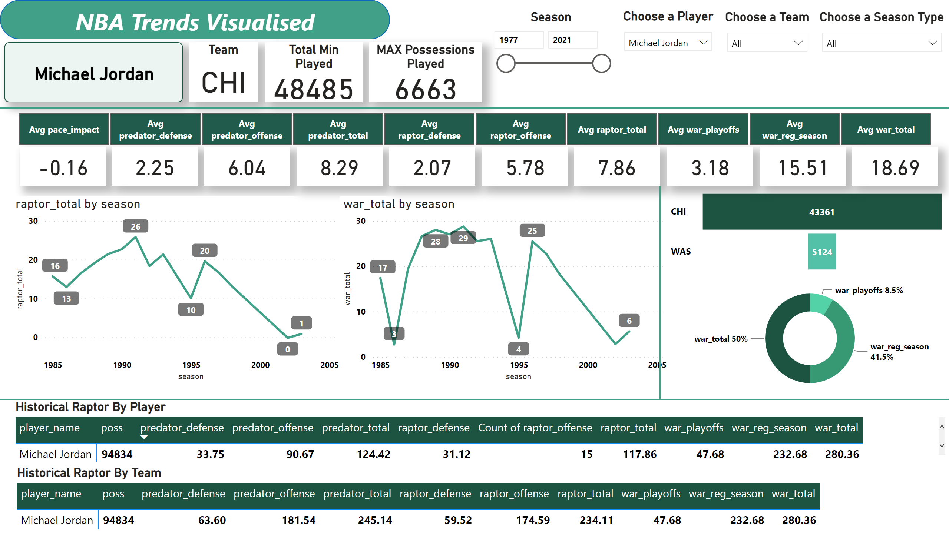
Historical_RAPTOR_by_player & team
Notes:
slicer
No alt text provided
card
No alt text provided
card
No alt text provided
card
No alt text provided
card
No alt text provided
card
No alt text provided
card
No alt text provided
card
No alt text provided
card
No alt text provided
card
No alt text provided
card
No alt text provided
lineChart
No alt text provided
lineChart
No alt text provided
funnel
No alt text provided
donutChart
No alt text provided
card
No alt text provided
Team
No alt text provided
Total Min Played
No alt text provided
MAX Possessions Played
No alt text provided
Season
No alt text provided
Choose a Player
No alt text provided
Choose a Team
No alt text provided
Choose a Season Type
No alt text provided
Historical Raptor By Team
No alt text provided
Historical Raptor By Player
No alt text provided
shape
No alt text provided
shape
No alt text provided
shape
No alt text provided
shape
No alt text provided

Slide 3
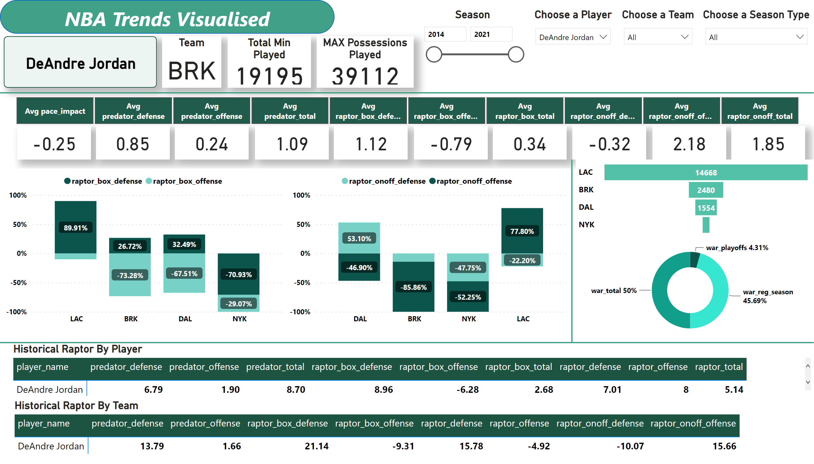
Modern_RAPTOR_by_player & team
Notes:
slicer
No alt text provided
card
No alt text provided
card
No alt text provided
card
No alt text provided
card
No alt text provided
card
No alt text provided
card
No alt text provided
card
No alt text provided
card
No alt text provided
card
No alt text provided
card
No alt text provided
hundredPercentStackedColumnChart
No alt text provided
hundredPercentStackedColumnChart
No alt text provided
funnel
No alt text provided
donutChart
No alt text provided
card
No alt text provided
Team
No alt text provided
Total Min Played
No alt text provided
MAX Possessions Played
No alt text provided
Season
No alt text provided
Choose a Player
No alt text provided
Choose a Team
No alt text provided
Choose a Season Type
No alt text provided
Historical Raptor By Team
No alt text provided
Historical Raptor By Player
No alt text provided
shape
No alt text provided
shape
No alt text provided
shape
No alt text provided
shape
No alt text provided

Slide 4
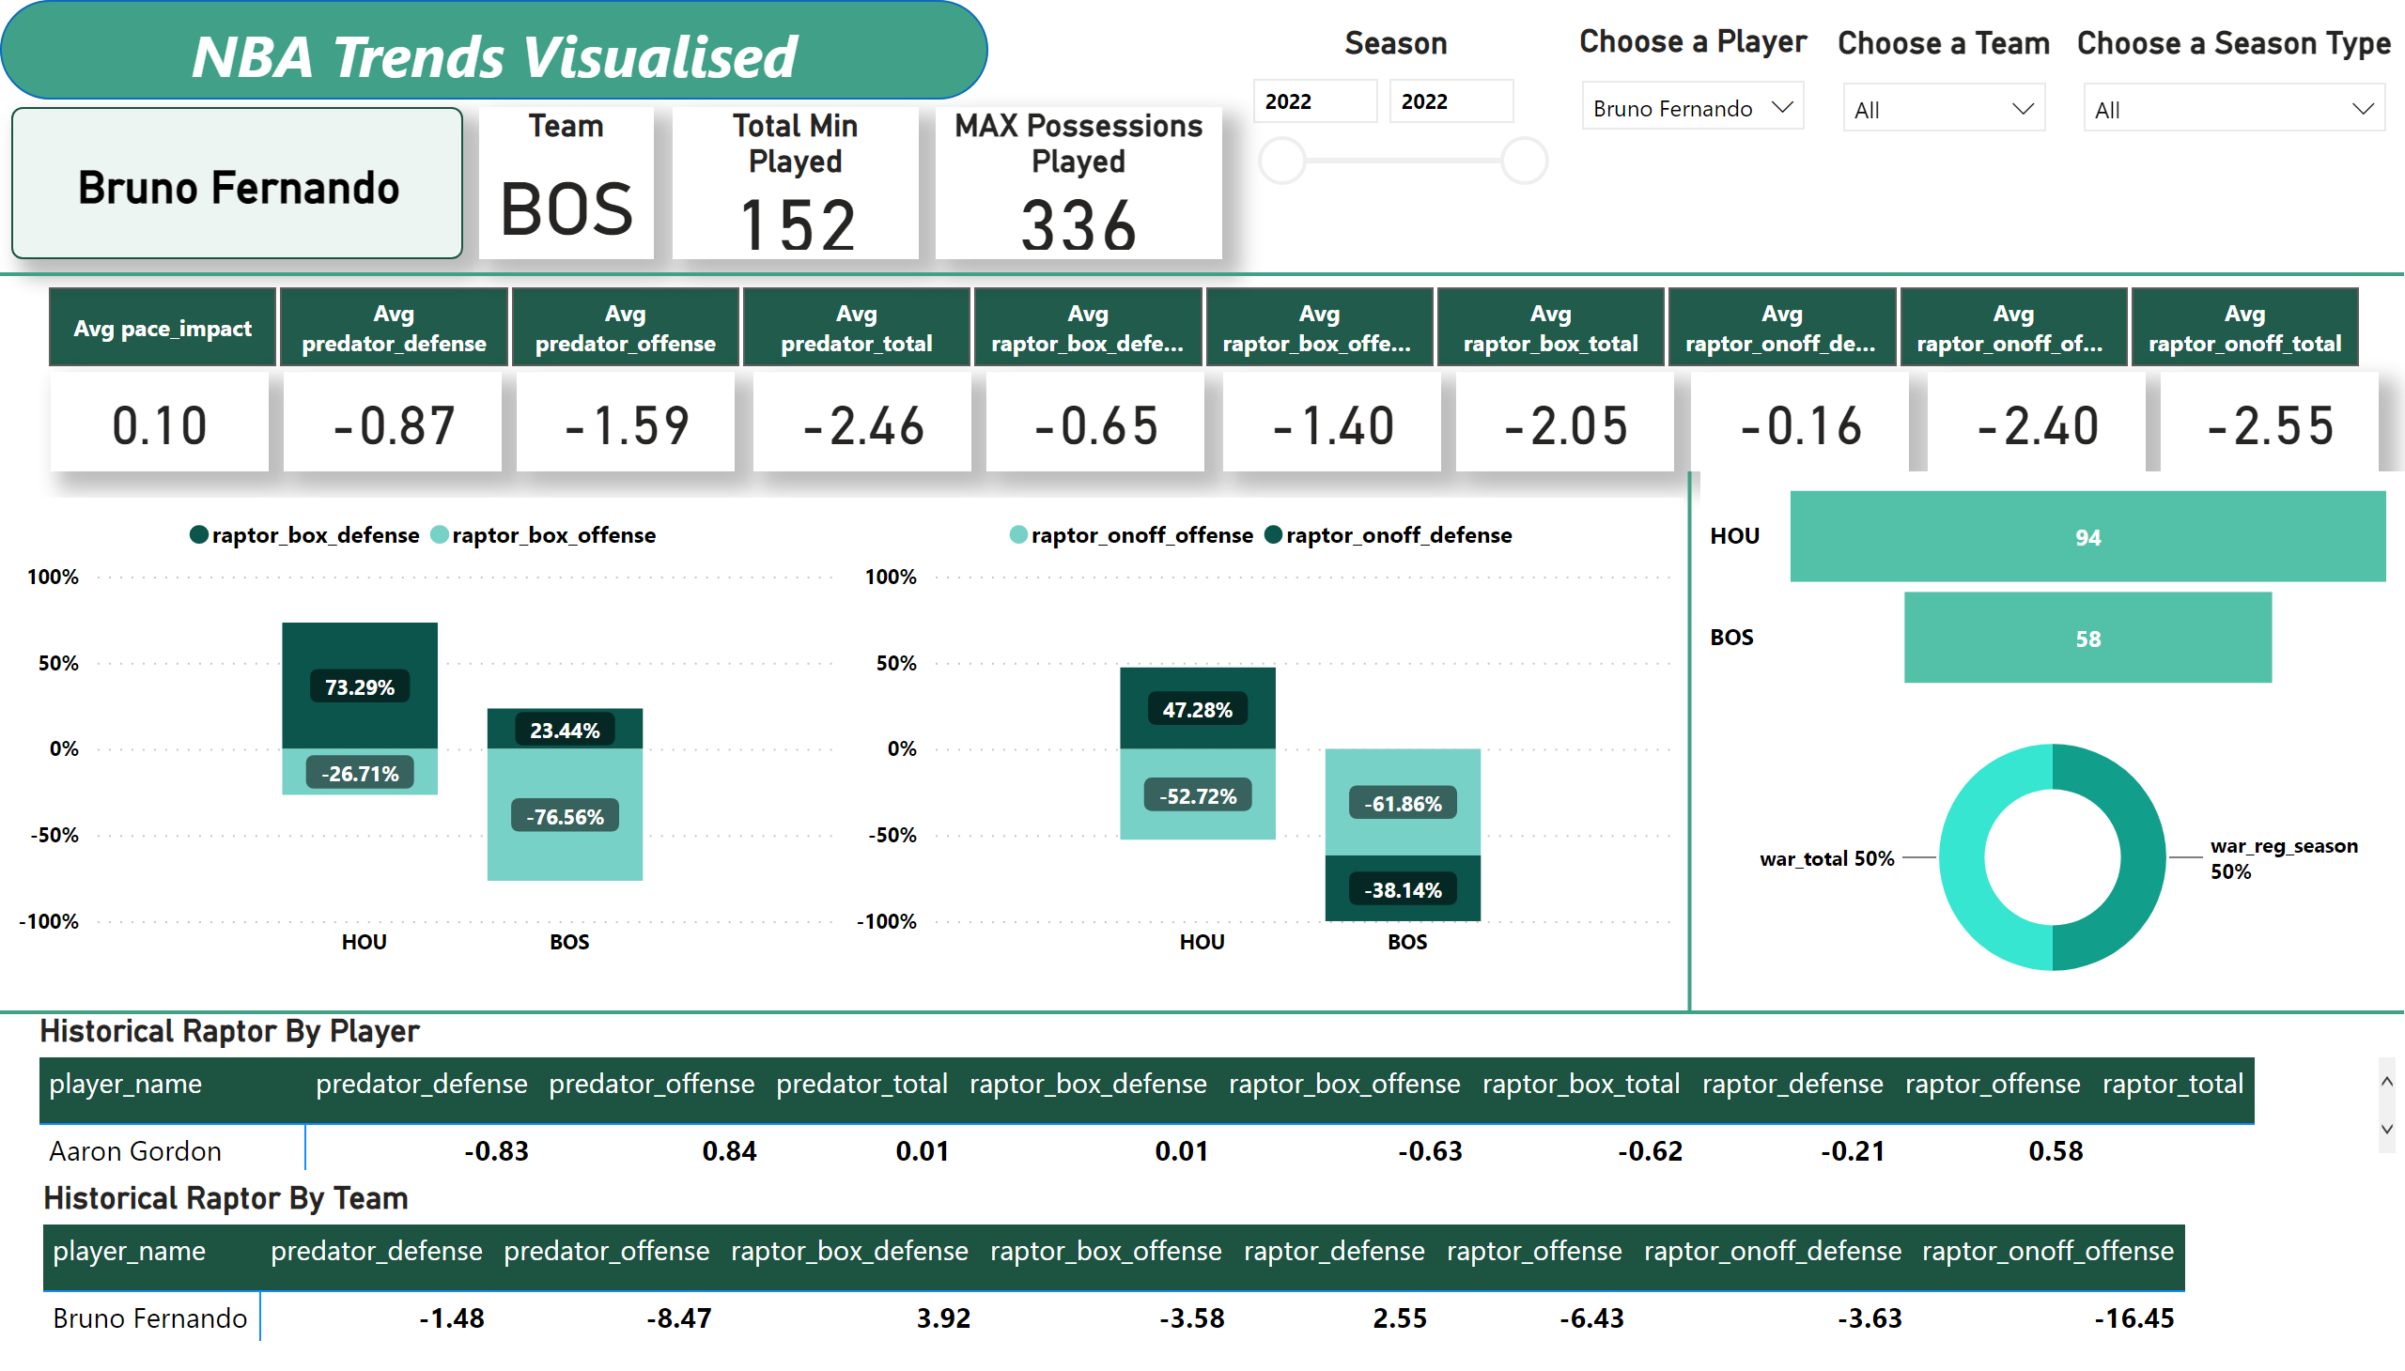
Latest_RAPTOR_by_player & team
Notes:
slicer
No alt text provided
card
No alt text provided
card
No alt text provided
card
No alt text provided
card
No alt text provided
card
No alt text provided
card
No alt text provided
card
No alt text provided
card
No alt text provided
card
No alt text provided
card
No alt text provided
hundredPercentStackedColumnChart
No alt text provided
hundredPercentStackedColumnChart
No alt text provided
funnel
No alt text provided
donutChart
No alt text provided
card
No alt text provided
Team
No alt text provided
Total Min Played
No alt text provided
MAX Possessions Played
No alt text provided
Season
No alt text provided
Choose a Player
No alt text provided
Choose a Team
No alt text provided
Choose a Season Type
No alt text provided
Historical Raptor By Team
No alt text provided
Historical Raptor By Player
No alt text provided
shape
No alt text provided
shape
No alt text provided
shape
No alt text provided
shape
No alt text provided
slicer
No alt text provided

Slide 5
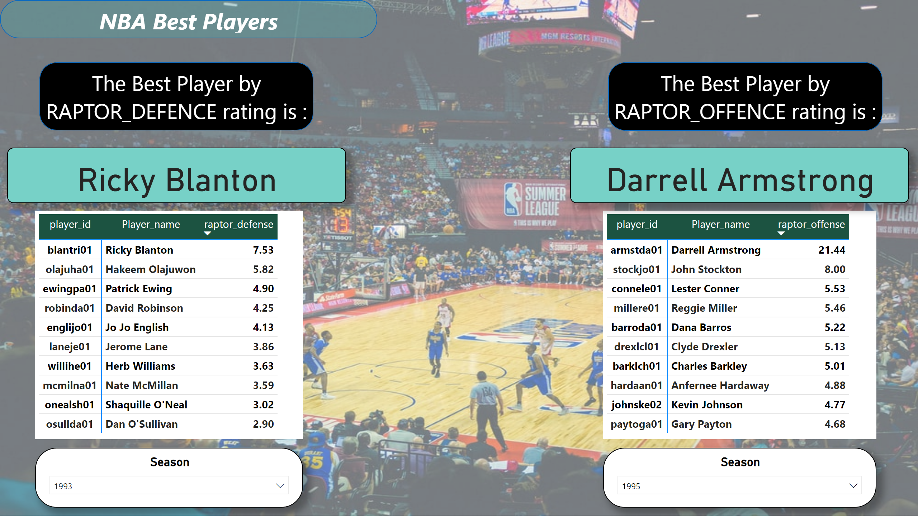
Best Players
Notes:
shape
No alt text provided
card
No alt text provided
pivotTable
No alt text provided
Season
No alt text provided
shape
No alt text provided
pivotTable
No alt text provided
Season
No alt text provided
card
No alt text provided
shape
No alt text provided

